Slide 1
WTA Mini Project
Reducing Web Crawler Overhead using Mobile Crawler
Topic:

Slide 2
TEAM MEMBERS
Group Head:
S.Gopinath 12IT64 123nathgopi@gmail.com
Members:
Manish Kumar 12IT41
S.Vinay Kumar 12IT66
Shashi Roshan 12IT73

Slide 3
Introduction
World Wide Web contains more than 2000 billion visible pages.
Due to the extremely large number of pages present on Web, the search engine depends upon crawlers for the collection of required pages.
Web crawlers are used to recursively traverse and download web pages for search engines to create and maintain the web indices. The needs of maintaining the up to date pages in the collection cause a crawler to revisit the websites again and again.
A crawler for a large search engine has to address two issues:
it has to have a good crawling strategy
it needs to have a highly optimized system architecture

Slide 4
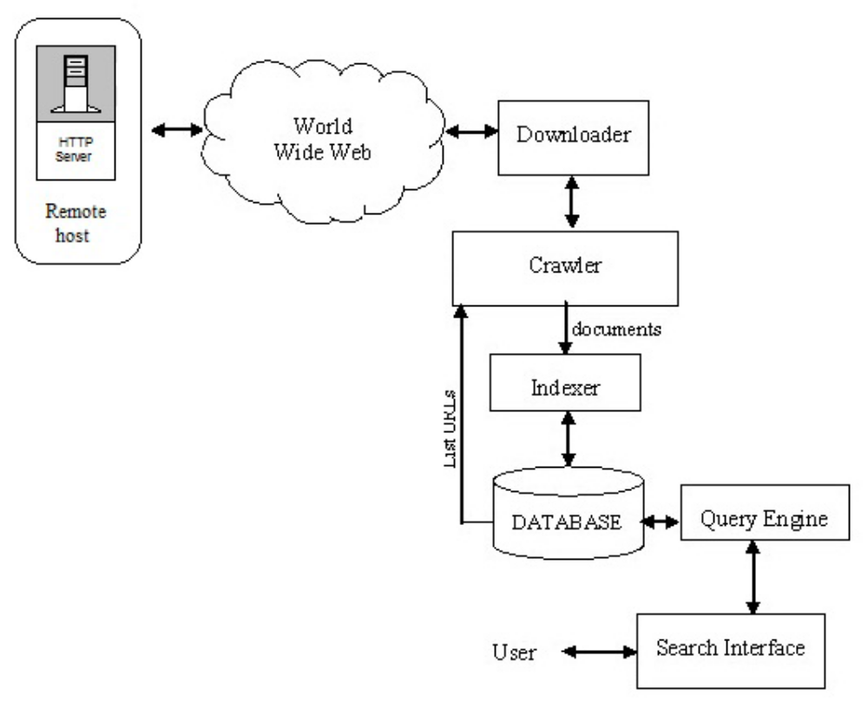
Standard Web Search Engine Architecture

Slide 5
ISSUES OF EXISTING CRAWLERS
To maximize the coverage rate of web resources, Crawlers also download a large amount of useless information.
A large amount of web pages are written in JavaScript or Ajax. It’s impossible to extract new URLs by tag matching because these link URLs are generated by JavaScript functions.
Most of Crawlers only support keywords search, but not the attribute search.

Slide 7
Proposed Work

Slide 8
Mobile Agent Based Crawling
Agent?
An agent is a software program that acts on behalf of a user, or another software program
Mobile Agent?
Mobile agents are a distributed computing paradigm
A mobile agent migrates from one machine to another under its own control
  Decides which locations to visit and what commands to execute
  Interaction with the original source isn't required
Notes:
<number>

Slide 9
Advantages of Mobile Agents
Reduce bandwidth consumption and network load
  Local communication between agent and host
Act autonomously
Well suited to distributed mobile applications
  Limited resource devices
    Processing can be moved to resource rich devices
  Frequent network disconnections
    Rather than deal with network exceptions, the agent migrates when a connection is available

Slide 10
Components of Mobile Crawler
The major components of Mobile Crawler are :
a) Crawler Manager
b) Statistics Database (SD) Module
c) Old Database File Module (ODBFM)
d) Compare Module (CM)
e) Near Duplicate Detector (NDD) Module
Notes:
<number>

Slide 11
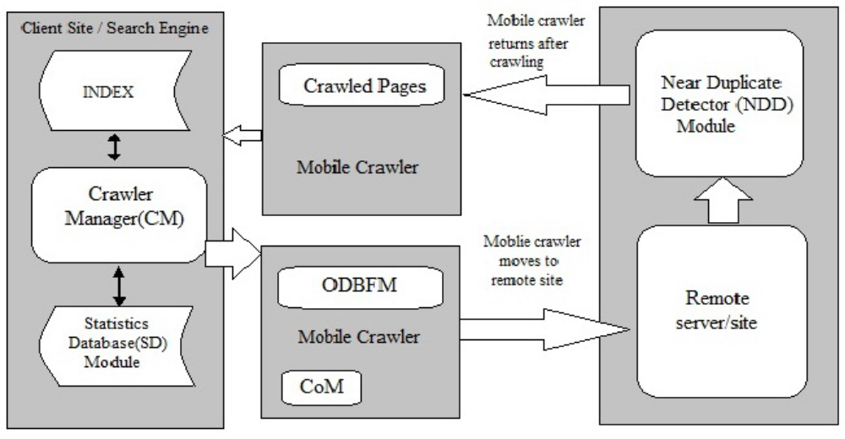

Slide 12
A. Crawler Managar (CM)
The major tasks of Crawler Manger are :
  Mobile crawler generation
  Delegation of URL's to the mobile crawler for crawling
  Construction of ODBFM for each mobile crawler
  Updating the statistics database module
  Receiving the crawled pages from the Remote Server
Notes:
<number>

Slide 13
B. Statistics Database (SD) Module
The SD Module is mainteined at the Client Site (Search Engine)
It contains information about all the pages crawled by the mobile crawlers
Contains two fields :
  Name of URL
  Size of the web page
Notes:
<number>

Slide 14
C. Old Database File Manager (ODBFM)
ODBFM contains statistics about each URL to be crawled
Sent with corresponding mobile crawler to the Remote Site
Created afresh from SD module for every new crawl
Module deleted after each crawl
Consists of
  Name of the URL
  Size of the web page
Notes:
<number>

Slide 15
D. Comparator Module
The major function – to compare the size of each URL (web page) taken from ODBFM with the size of corresponding URL retrieved from Remote Server in order to know whether the page has been modified or not.
If there is difference then it indicated difference and only those pages sent to client side
Notes:
<number>

Slide 16
E. Near Duplicate Detector (NDD) Module
Numerous similar pages may exist at remote site
NDD Module proposed – to detect and remove the pages during crawling
Near duplicates – not bit wise identical but strongly similar
Reducing these duplicates – for efficiency
Notes:
<number>

Slide 17
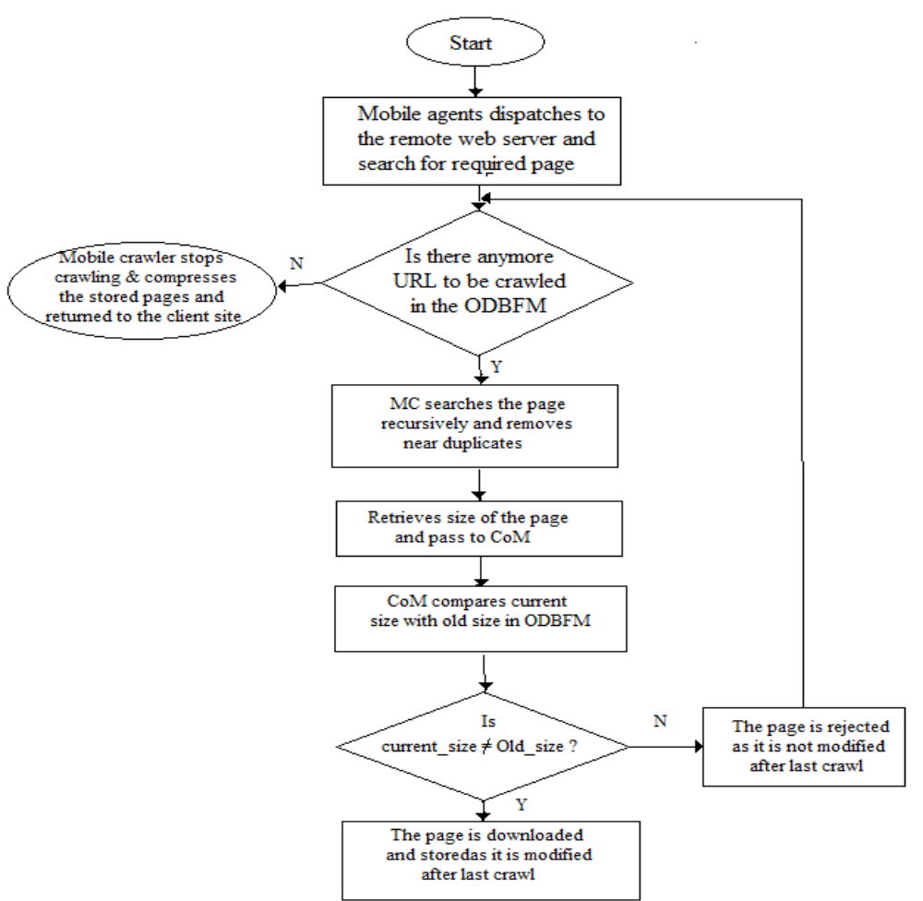
Working of Mobile Agent Based Crawler

Slide 18
Project Progress

Slide 19
Installed and Configured Tahiti Server in Ubuntu.
Supporting Environment (variables and path) has been set for JDK and Aglets.
Created a List of 60 URLs and downloaded and stored their webpages in the server site.

Slide 20
Tools Used

Slide 21
Aglets
Java based mobile agent toolkit developed by IBM
  The name originates from agent+applet = Aglet
Aglet properties:
  Aglet = Aglet state (variable values) + Aglet code (Java class)
  Autonomous
    Runs in a separate thread when it arrives at a host
  Reactive
    Responds to messages that are sent to it.
  Is unique
    A globally unique identifier is bound to each aglet
Notes:
<number>

Slide 22
Tahiti
An application program that runs as an agent server.
Multiple servers on a single computer by assigning them different port number.
Provides a user interface for monitoring, creating, dispatching, and disposing of agents and for setting the agent access privileges for the agent server.

